Slide 1



KaggleX- Showcase Oct 2023
Notes:
Recommending picking out he most interesting and important parts from your documentation.

Slide 2
Semi Supervised Learning through GANs
Akshay Pratap Singh

Slide 3
Table of Content
1. Background
2. Project Definition
I. Project Summary
II. Project Potential
III. Topic Applied
IV. What I learned
3. Steps Applied
4. Project Example
5. Model evaluation and accuracy
6. Project Links

Slide 4
Background
Academic Background : Bachelors in Computer Science and information Technology(ongoing).
Aspiration : Data Scientist (Specialization in GenAI), Data Analyst.
Experience : 2+ years of experience in Data Space.
Python, SQL, TensorFlow.
Machine Learning, Deep Learning, CNN, RNN.
AWS, ETL.
Profile :
https://www.linkedin.com/in/axshay007/
https://github.com/axshay007
https://medium.com/@axshay007
https://www.kaggle.com/axshay007

Slide 5
Project Definition
Project Summary
Develop a deep learning model for classifying malignant vs. benign images from low-res cellphone photos.
Utilize semi-supervised learning and data augmentation on a limited labeled dataset.
Train a DCGAN to create realistic mole-like images and classify labeled malignant and benign images.
The project aims to produce a highly accurate and generalizable model for early melanoma detection in low-res photos via a mobile app.
Potential Impact
The model could enhance early melanoma detection from low-res photos, enabling a global mobile app, especially beneficial in areas with limited healthcare access.
Beyond melanoma, it offers opportunities to create models for medical imaging in data-scarce scenarios, fostering innovative disease diagnosis and treatment methods.

Slide 6
Data Science Topic Applied:
Semi-supervised Learning
What I Learned:-
Semi-supervised learning is a machine learning approach that can be used to train models with limited labeled data and a large amount of unlabeled data.
DCGANs (Deep Convolutional GANs) can be used to generate synthetic mole-like images that can be used to augment the labeled training data. The discriminator of a DCGAN can be trained to classify benign and malignant moles, even when trained on a limited dataset.
Benefits:-
Semi-supervised learning can be used to train a model with limited labeled data training data, which can improve the performance of the model.
The discriminator of a DCGAN can be trained to classify images eve, which is often the case for medical imaging data.
DCGANs can be used to generate synthetic images that can be used to augment the labeled n when trained on a limited dataset, which makes it suitable for use in a mobile app.
Challenges:-
It can be difficult to collect a large dataset of labeled mole images.
Training a DCGAN can be computationally expensive.
It can be difficult to tune the hyperparameters of the DCGAN and the discriminator to achieve good performance.

Slide 7
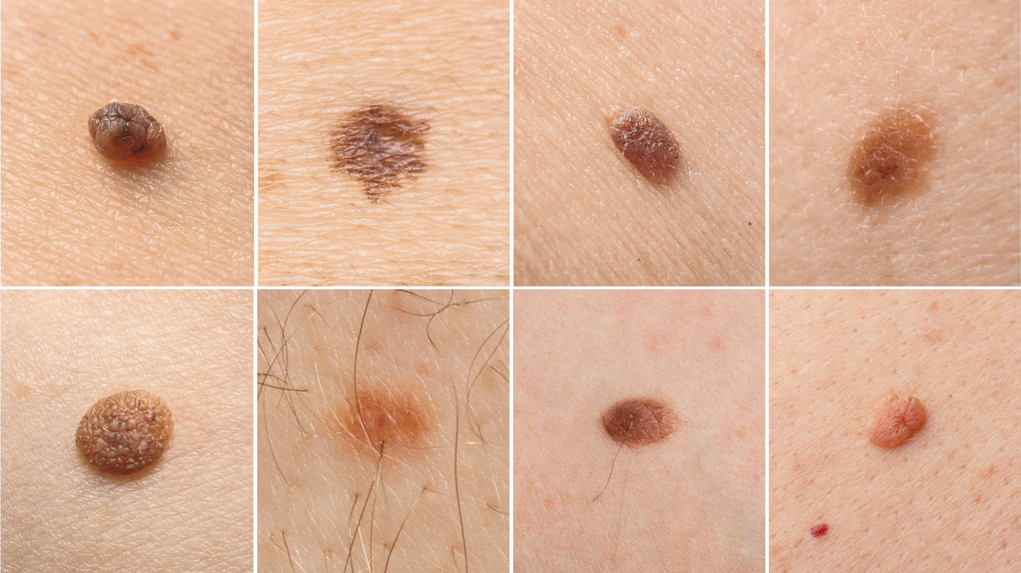
Steps Applied:- Step 1 :
Collect a dataset of labeled and unlabeled mole images.
32x32 pixel photos of melanocytic nevi (moles)
Data Sources :
Labelled as Benign or Malignant : https://dataverse.harvard.edu/dataset.xhtml?persistentId=doi:10.7910/DVN/DBW86T
Unlabelled data : https://drive.google.com/file/d/1q6VtRcldzXkYHVrYaHw24MIoEXzicpLO/view?usp=sharing

Slide 8
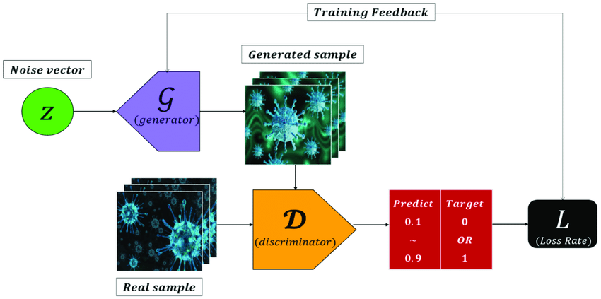
Step 2 : Use GANs model to generate realistic images of moles using generator and discriminator.

Slide 9
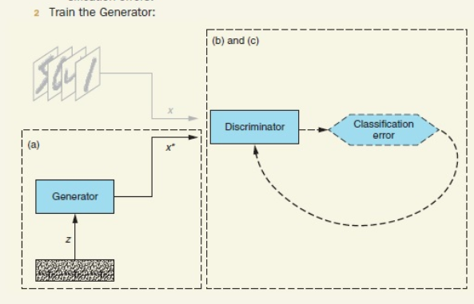
Step 3 : Train a generator of DCGAN to generate synthetic mole-like images.
Get a new random noise vector z and, using the Generator network, synthesize a fake example x ^ *.
Use the Discriminator network to classify x ^ * .
Compute the classification error and backpropagate the error to update the Generator weights and biases, seeking to maximize the Discriminator's error.

Slide 10
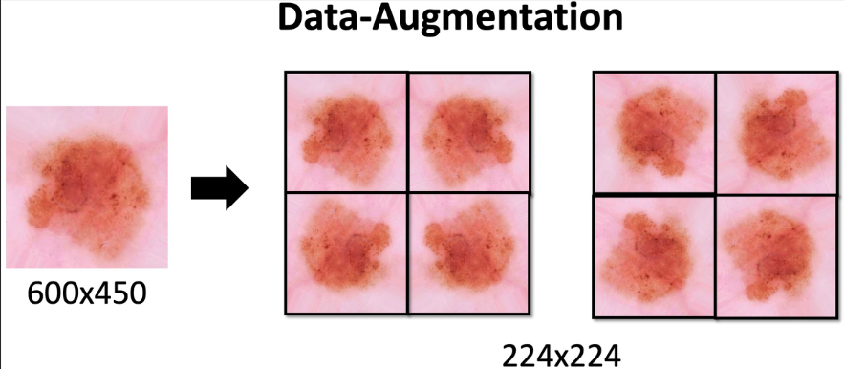
Step 4 : Augment the labeled training data with the synthetic images.
Expand dataset diversity and size with data augmentation (e.g., crop, flip, rotate, adjust colors) to prevent overfitting.
Improve model generalization by training on a wider dataset, enhancing understanding of melanoma and benign nevi patterns for better performance on new data.
Encourage robust feature learning, even under varying conditions.
Enhance DCGAN performance by augmenting training images to create realistic mole-like images for improved discriminator accuracy.

Slide 11
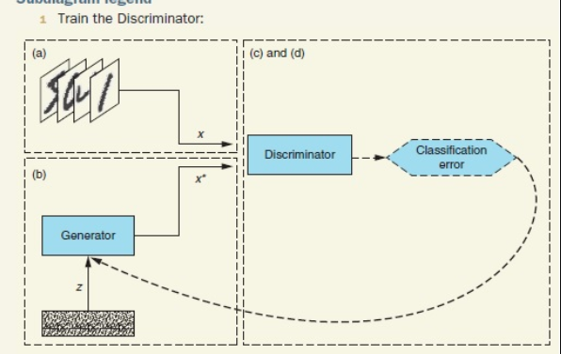
Step 5 : Train the discriminator of the DCGAN to classify benign and malignant moles.
Take a random real example x from the training dataset.
Get a new random noise vector z and, using the Generator network, synthesize a fake example x ^ *.
Use the Discriminator network to classify x and x ^ *.
Compute the classification errors and backpropagate the total error to update the Discriminator weights and biases, seeking to minimize the classification errors.

Slide 12
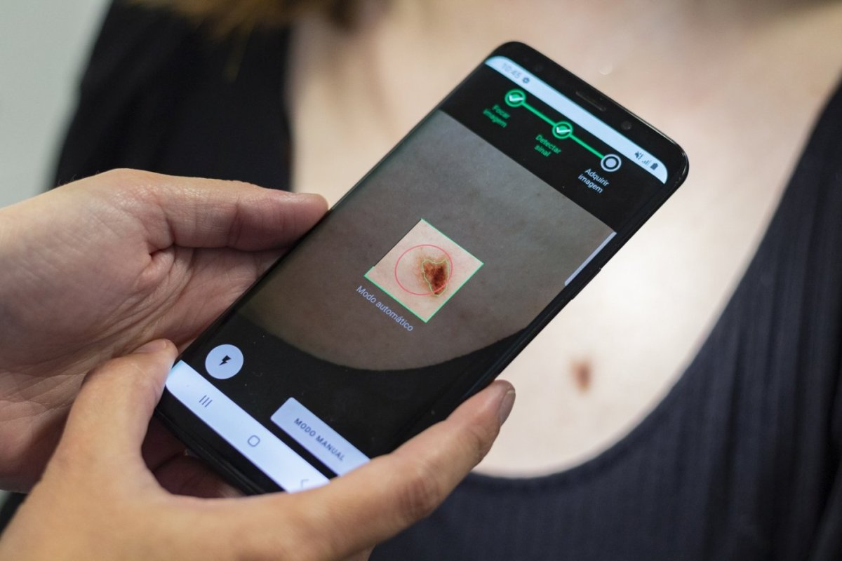
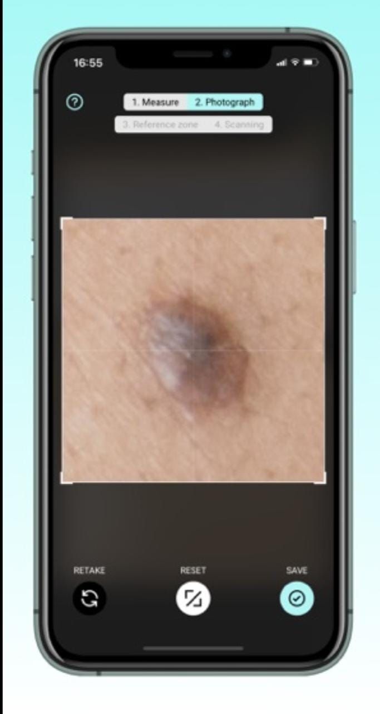
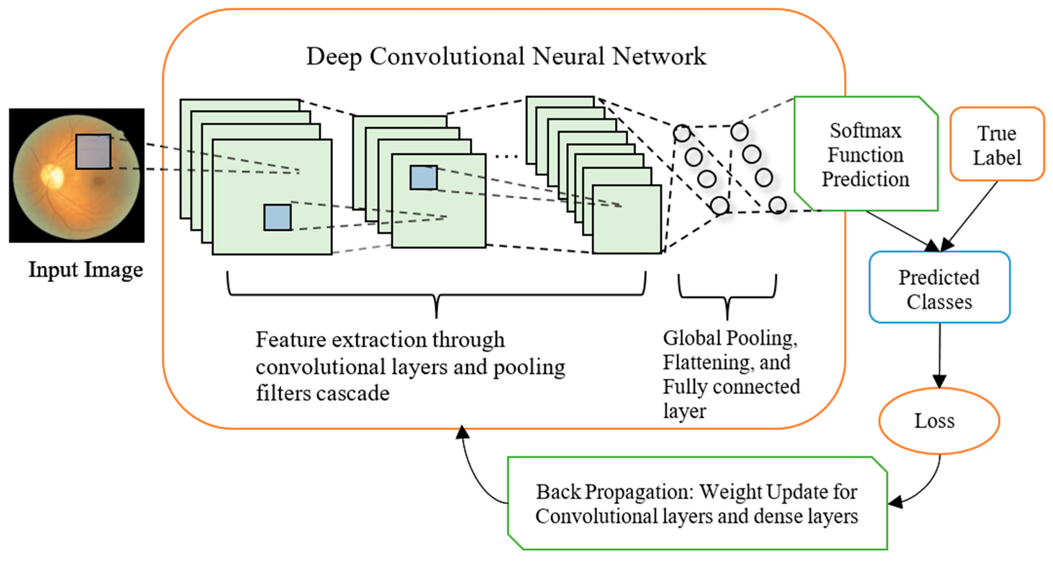
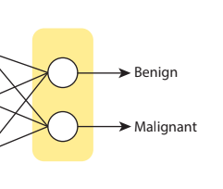
Step 6 : Deploy the trained discriminator to a mobile app.
Project Examples
Workflow of the project
Deploying a GANs model on a mobile app to allow users to scan moles and instantly receive a classification of malignant or benign.

Slide 13
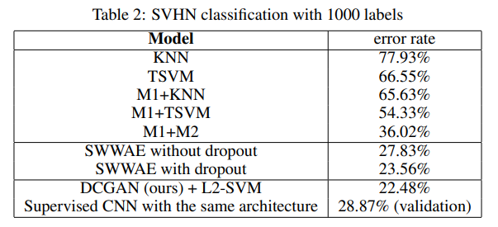
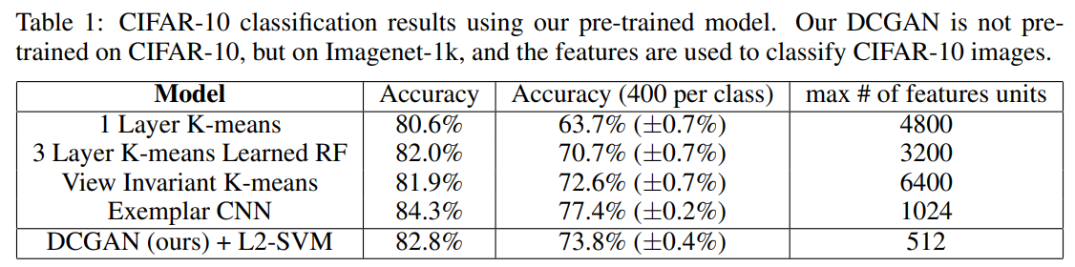
Model evaluation and accuracy
Error rate when DCGAN used for supervised purpose for SVHN dataset
Source
DCGAN - 1511.06434v2.pdf (arxiv.org)

Slide 14
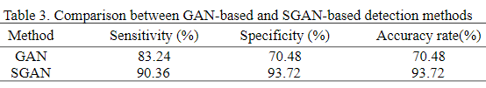
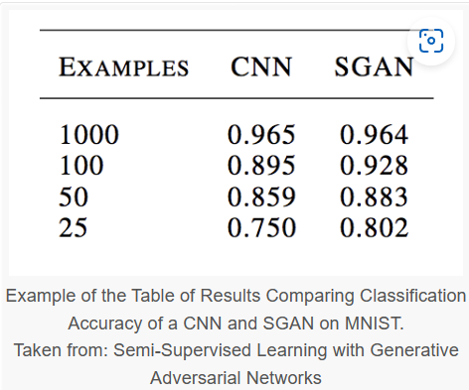
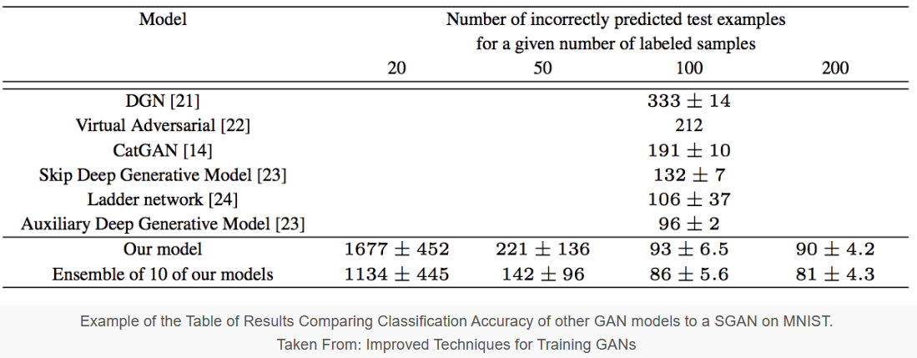
Epileptic Seizure detection comparison
Source
SGAN - How to Implement a Semi-Supervised GAN (SGAN) From Scratch in Keras - MachineLearningMastery.com
https://www.researchgate.net/publication/373185472_Epileptic_Seizure_Detection_Based_on_Semi-supervised_Generative_Adversarial_Network

Slide 15
Project Links
Medium : https://axshay007.medium.com/deep-convolutional-gans-for-melanoma-detection-a-semi-supervised-learning- approach-47f290c1a802
GitHub : https://github.com/axshay007/Semi-Supervised-Learning-through-GANs.git
Thankyou

